Slide 1
INCREASE CLINICIAN - PATIENT FACETIME
PIP2001 Capstone Project
Review-3
Batch Number:CAI-G19
ROLL NO | NAME
20211CAI0112 | SHOVIN WILSON AW
20211CAI0109 | S SRINIVAS
20211CAI0080 | R KESHAV
20211CAI0087 | RAKSHITHA K T
20211CAI0187 | PREM JE KALISTER
Under the Supervision of,
Dr. AKSHATHA Y,
Assistant Professor,
School of Computer Science and Engineering,
Presidency University.
Name of the Program: B.TECH
Name of the HoD: Dr. Zafar Ali Khan
Name of the Program Project Coordinator: Dr.Afroz Pasha
Name of the School Project Coordinators: Dr. Sampath A K / Dr. Abdul Khadar A / Mr. Md Ziaur Rahman

Slide 2
CONTENT
Introduction
Literature Review
Research Gaps Identified
Proposed Method
Objectives
Methodology/Modules
System Design and Implementation
Hardware/software components

Slide 3
CONTENT
Timeline of Project
Outcomes/Results Obtained
Conclusion
Github link
References
Project work mapping with SDG

Slide 4
PROBLEM STATEMENT
The healthcare industry faces a significant challenge with the increasing administrative burden on clinicians, primarily due to extensive documentation requirements. This issue reduces the time clinicians can dedicate to direct patient care, impacting the quality of healthcare delivery and contributing to clinician burnout. Traditional documentation methods are time-intensive, prone to errors, and inefficient, often resulting in delays in clinical decision-making and reduced patient satisfaction.
There is a pressing need for an innovative solution to automate the documentation process, integrate seamlessly with existing systems, and enhance clinician-patient interactions while maintaining accuracy, adaptability, and trust. This solution should streamline workflows, reduce administrative workload, and improve patient outcomes through timely and precise care delivery.
The Increase Clinician-Patient Facetime project addresses this problem by leveraging advanced artificial intelligence technologies such as automatic speech recognition, natural language processing, and machine learning to revolutionize clinical documentation and decision-making processes.

Slide 5
Introduction
Healthcare systems worldwide face a dual challenge: delivering high-quality patient care while managing extensive documentation requirements. Clinical documentation, though essential for maintaining patient records, research, and compliance, is a time-consuming process. Studies indicate that physicians spend nearly 50% of their time on administrative tasks, which significantly impacts their ability to engage with patients effectively.
Artificial intelligence offers a transformative solution to this problem by automating tasks that traditionally required manual intervention. By leveraging advanced technologies like automatic speech recognition (ASR) and natural language processing (NLP), it is possible to create a system that not only transcribes medical conversations but also analyzes and processes them to derive actionable insights. The Increase Clinician-Patient Facetime project embodies this vision by introducing a streamlined pipeline that integrates these technologies to produce accurate and insightful patient reports.

Slide 6
Introduction
Artificial Intelligence (AI) has revolutionized healthcare by significantly enhancing diagnostic accuracy, personalizing treatments, and improving patient outcomes. In medical imaging and diagnostics, AI-driven deep learning models have demonstrated remarkable accuracy in interpreting images, enabling early detection of diseases like cancer and neurological disorders. AI has also transformed virtual patient care with intelligent assistants and chatbots that provide real-time health information, schedule appointments, and send medication reminders, fostering better patient engagement and compliance. Additionally, AI has expedited drug discovery and development by predicting molecular behaviors, identifying potential drug candidates, and optimizing clinical trials, effectively reducing the time and cost of bringing new drugs to market. These advancements highlight AI's transformative potential across multiple facets of healthcare.

Slide 7
Literature Review
Paper Referred | Author Name | Advantages | Disadvantages
Efficient Fine-Tuning of Large Language Models for Automated Medical Documentation | Hui Yi Leong, Yi Fan Gao, Uktu Pamuksuz, and Sanjay Krishnan | High performance in generating accurate, coherent reports. 75% of notes require no manual correction. | Struggles with unique clinical dialogues. Requires extensive fine-tuning for adaptability.
Efficient Fine-Tuning of Large Language Models for Automated Medical Documentation | Hui Yi Leong, Yi Fan Gao, Uktu Pamuksuz, and Sanjay Krishnan | High performance in generating accurate, coherent reports. 75% of notes require no manual correction. | Struggles with unique clinical dialogues. Requires extensive fine-tuning for adaptability.
Deep Neural Network Driven Speech Classification for Relevance Detection | Suhail Ahamed, Gabriele Weiler, Karl Boden, Kai Januschowski, Matthias Stennes, Patrick McCrae, Cornelia Bock, Carina Rawein, Marco Petris, Kilian Foth, Kerstin Rohm, and Stephan Kiefer | 92.41% accuracy in speech classification. Handles speaker variability (gender, accents, etc.). | Limited generalizability to diverse medical contexts. Requires robust preprocessing for noisy data.
Structured Notes Using ChatGPT-4 | J. Smith, L. Brown, and M. Lee | Generates structured, standardized notes. Consistent SOAP-style formatting. | High error rates in generated notes. Struggles with complex cases.

Slide 8
Literature Review
Paper Referred | Author Name | Advantages | Disadvantages
Paperwork versus Patient Care | Ann S. O'Malley, Valerie A. Lewis, and Diane R. Rittenhouse | Highlights how documentation impacts patient interaction. Supports automation to reduce administrative burden. | Resistance due to burnout may hinder adoption. Automation could limit teaching opportunities.
Random Forests and Decision Trees | L. Breiman, J. Friedman, R. Olshen, and C. Stone | Robust models for disease prediction. Proven applications in medical diagnosis. | Outdated datasets affect prediction quality. Focus limited to older methods like Random Forest.
Automated Generation of Clinical Reports Using Sensing Technologies | John M. Kane, T. Peter, and G. A. Shipley | Accurate topic extraction using GPT-2 and BART models. Reduces administrative workload. | Low performance in summary precision. Insufficient fine-tuning datasets.
Intelligent Speech Technologies for Smart Hospitals | A. Graves, A. Mohamed, and G. Hinton | Eases medical documentation burden. Broad applications in transcription and diagnosis. | Small datasets limit reliability. Privacy and evaluation challenges.

Slide 9
Literature Review
Paper Referred | Author Name | Advantages | Disadvantages
Analysis of Documentation Speed Using Web-Based Medical ASR | David A. Hanauer, Kai Zheng, and Patricia A. Green | 26% improvement in documentation speed. Enhanced clinician satisfaction. | Longer documents require concise formatting. Persistent errors need robust correction.
Challenges of Developing a Digital Scribe | N. Patel, S. S. Kannampallil, and V. L. Patel | Improves clinician-patient interaction. Reduces administrative stress. | May reduce critical thinking in care. Workflow adaptation challenges.
Using AI for Exercise Prescription | M. Williams, J. R. Matthews, and S. K. Reddy | Broadens healthcare access. Ensures safety-focused recommendations. | Limited personalization of recommendations. Long-term effectiveness needs improvement.
Intelligent Clinical Documentation with Generative AI | E. J. Topol and A. S. Poplin | Reduces administrative burdens efficiently. Maintains high documentation standards. | Data privacy concerns. Manual validation required.

Slide 10
Research Gaps Identified
Siloed Functionalities : AI solutions often address specific tasks—such as transcription, analysis, or prediction—independently, lacking seamless integration. This limits their utility in clinical settings where end-to-end automation is crucial. Example: Transcription systems like Dragon Medical One excel at speech-to-text conversion but cannot contextualize information for predictive analysis.
Handling Noisy or Incomplete Data: Clinical environments produce audio with challenges such as background noise, interruptions, or overlapping dialogues, which reduce transcription accuracy. Patient records often include unstructured data with varied formats, creating inconsistencies in NLP-based analysis. Study Insight: Patel et al. (2024) highlighted that adaptive noise-cancellation techniques and semi-supervised learning enhance model robustness but require further refinement.
Lack of Real-Time Processing: Existing systems struggle with real-time integration of diverse data types, such as imaging, lab results, and patient histories, which is critical for timely decision-making.

Slide 11
Research Gaps Identified
Multilingual Support: Existing systems predominantly cater to English-speaking users, limiting their applicability in linguistically diverse regions. There is a need to develop multilingual ASR and NLP models tailored to regional healthcare practices for global adoption.
Domain-specific Adaptation : Current models struggle with domain-specific terminology and medical jargon, reducing their accuracy in specialized fields of medicine. Customizing models to handle niche healthcare vocabularies remains an underexplored area.
Ethical and Privacy Challenges : Compliance with regulations like HIPAA and GDPR introduces complexities in deployment. Concerns about data ownership, algorithmic transparency, and fairness in AI predictions are often overlooked.
Data Quality and Accessibility: Many AI models rely on clean, structured datasets, which are scarce in real-world clinical settings. Poor-quality data hampers the effectiveness of predictive models and increases the effort required for pre-processing.

Slide 12
Proposed Method
Automatic Speech Recognition (ASR):
ASR plays a crucial role in converting audio data (clinician-patient conversations) into text. OpenAI’s Whisper model, a transformer-based model for automatic speech recognition, provides high accuracy in transcribing both clean and noisy audio. Whisper is known for its robustness in handling diverse accents and medical jargon, which makes it ideal for this application. The model can transcribe speech from various languages, which can be particularly beneficial in global healthcare settings. Furthermore, Whisper uses end-to-end training, allowing it to transcribe speech in one step, without the need for intermediate processes like phoneme recognition.
2. Natural Language Processing (NLP):
Processes transcripts to identify symptoms and medical terms. Once the audio is transcribed into text, NLP techniques such as Named Entity Recognition (NER) and syntactic parsing are used to process the transcripts. These methods identify medical terms, symptoms, and body parts. Symptom extraction is crucial for creating accurate disease predictions. NLP also aids in text normalization, which ensures that abbreviations or shorthand terms in the conversation are converted into standardized medical terms.

Slide 13
Proposed Method
3. Disease Prediction Module:
Matches extracted symptoms with a medical dataset to predict potential diseases. The disease prediction module is designed to match the extracted symptoms against a curated medical dataset. This can involve fuzzy matching techniques like Rapid Fuzz, which ensures that even if there is slight variation in terminology or spelling, the system can still match symptoms with diseases accurately. The machine learning model, often a Random Forest classifier for multi-class classification, can be trained on historical medical data to predict diseases based on symptom patterns. This module helps in suggesting possible diagnoses based on the conversation.
4. Report Generation Module:
Compiles results into a structured, professional report, including prescriptions and recommendations. After the disease prediction is completed, a report is automatically generated that includes all necessary medical details, including patient information, the transcribed conversation, identified symptoms, disease predictions, and medical recommendations or prescriptions.

Slide 14
Objectives
Primary Objectives:
Accurate Transcription of Conversations:
Achieve over 70% transcription accuracy for medical conversations, even in noisy conditions or with diverse accents, using advanced ASR models like OpenAI's Whisper, tuned for medical terminology. Automate real-time audio transcription to ensure fast and reliable conversion of clinician-patient interactions into text, enhancing efficiency and accuracy.
Extraction of Symptoms and Medical Terms:
Use NLP models like BioBERT and SpaCy’s medical NER, along with Rapid Fuzz for fuzzy matching, to identify and categorize symptoms, body parts, and conditions from transcribed conversations. Preprocess text and fine-tune models for high precision, minimizing false positives and ensuring clinical relevance.
Disease Prediction Based on Extracted Symptoms:
Develop a machine learning model to predict diseases based on extracted symptoms and medical entities, trained on domain-specific datasets like MIMIC-III or SNOMED CT. Ensure the model uses high-quality, up-to-date data reflecting current clinical practices and is validated through clinical evaluation to ensure reliable, real-world performance.
Automated Report Generation:
Create an automated system to generate structured medical reports that consolidate transcriptions, identified symptoms, and disease predictions into standardized formats for clinical workflows. Ensure the reports are clinically relevant, easy to interpret, and include actionable insights, such as recommended next steps for diagnosis or treatment.

Slide 15
Objectives
Secondary Objectives:
Enhancing Clinician Productivity :
Automate repetitive tasks like transcription, symptom extraction, and report generation to reduce the time clinicians spend on documentation. This allows clinicians to focus more on patient care and diagnosis, improving clinical efficiency and patient outcomes by minimizing administrative burden.
Scalability Across Specialties:
Design the system to be adaptable across medical specialties, handling diverse terminologies and requirements. Ensure compatibility with multi-lingual and region-specific datasets to support global adoption and international clinical practices.
Data Privacy and Security:
Implement strong encryption and access control measures to secure patient interactions and ensure compliance with privacy regulations. Adhere to HIPAA standards to securely manage patient data, safeguarding privacy and ensuring legal compliance.
User-Friendly Design:
Develop an intuitive interface for clinicians that provides clear, actionable insights with minimal training. Ensure seamless integration with EHR systems for automated extraction, processing, and presentation of medical data, improving usability and adoption in daily workflows.

Slide 16
Methodology/Modules
Automatic Speech Recognition (ASR) : ASR (Automatic Speech Recognition) converts audio (like clinician-patient conversations) into text. OpenAI's Whisper model is highly accurate, even with accents, medical terms, and noisy audio. It supports multiple languages, making it useful globally. Whisper simplifies the process by transcribing speech directly, without extra steps like phoneme recognition.
Natural Language Processing (NLP) : NLP analyzes transcripts to identify symptoms and medical terms. Techniques like Named Entity Recognition (NER) and parsing detect key details like symptoms and body parts. It also normalizes text, converting abbreviations or shorthand into standard medical terms, ensuring accuracy for disease predictions.
Disease Prediction Module : This module compares extracted symptoms with a medical dataset to predict possible diseases. It uses fuzzy matching (e.g., Rapid Fuzz) to handle variations in terms or spelling. A machine learning model, often a Random Forest classifier, is trained on historical data to identify diseases from symptom patterns, providing diagnostic suggestions.
Report Generation Module : This module creates a structured report with patient details, transcribed conversations, identified symptoms, disease predictions, and medical recommendations or prescriptions. It ensures all results are presented professionally and comprehensively.

Slide 17
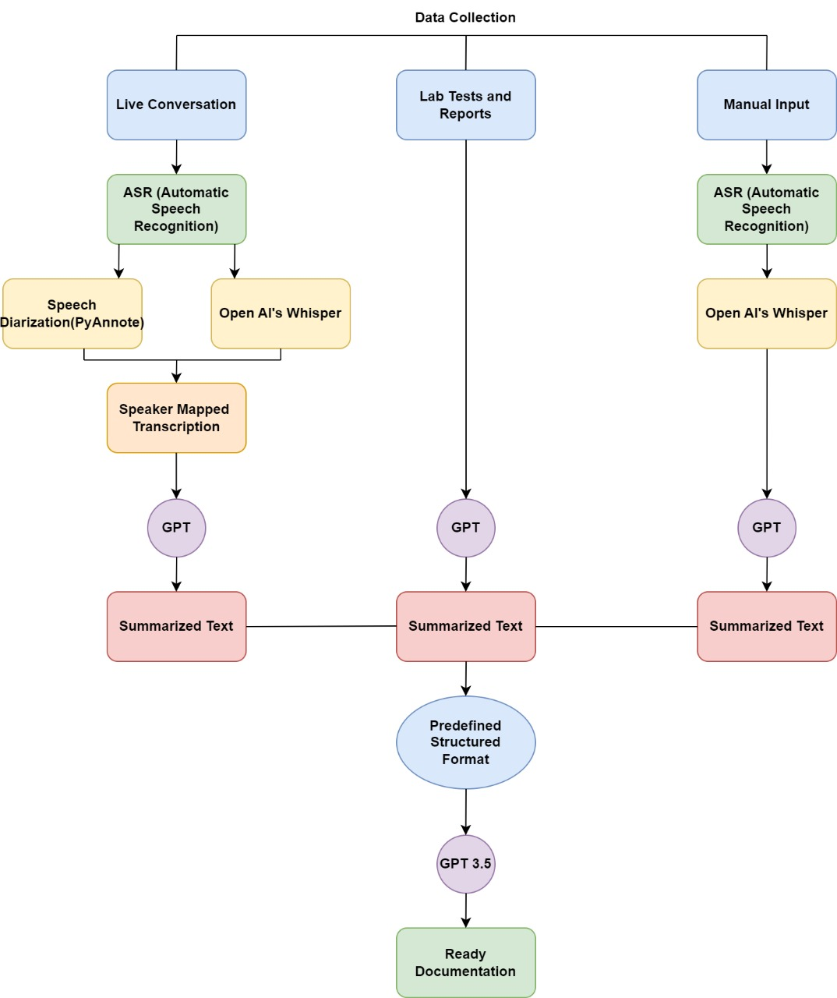
System Design & Implementation

Slide 18
System Design & Implementation
The system follows a layered, modular architecture that promotes independent development, testing, and scaling of its various components. This design approach ensures that updates or improvements in one layer can be executed without disrupting the overall system functionality. The architecture consists of four distinct layers:
Input Layer:
The system handles clinician-patient conversations in various audio formats, including MP3, WAV, and WEBM, allowing for both live audio streaming and file uploads. This flexibility ensures easy integration with existing clinic workflows. For real-time needs, live audio streaming enables immediate transcription and analysis, crucial for urgent medical scenarios where timely information is essential.
Processing Layer:
The system's Automatic Speech Recognition (ASR) module, powered by OpenAI's Whisper model, converts recorded audio into text. Whisper excels in noisy environments and can understand various accents, making it well-suited for diverse medical settings. The transcribed text is then processed through Natural Language Processing (NLP), where symptoms, medical terms, and relevant entities are extracted using advanced algorithms for entity recognition, tokenization, and negation detection. This ensures accurate interpretation of symptom descriptions and medical terminology, enhancing the system's diagnostic capabilities.

Slide 19
System Design & Implementation
Analysis Layer:
Extracted symptoms are mapped to a medical knowledge base using fuzzy matching algorithms like RapidFuzz, handling spelling variations and synonyms to ensure accurate interpretation across diverse clinician descriptions. These mapped symptoms are then analyzed by a Random Forest classifier, which leverages historical patient data to predict potential diseases based on the symptom patterns identified in the clinician-patient conversation.
Output Layer:
Once the analysis is complete, the system generates a detailed PDF report using the ReportLab library. The report includes transcriptions of the clinician-patient conversation, extracted symptoms, predicted diseases, and medical recommendations, all structured with clear headings, tables, and professional formatting for easy interpretation by clinicians.

Slide 20
Hardware/software components
Software Requirements:
Operating System: Windows 10/11
RAM: Minimum 4GB, Recommended 8GB and above
Processor: Intel i3/AMD Ryzen 5 and Above
IDE: Jupyter Notebook, Visual Studio Code, GitHub Codespaces, Google Colab
Cloud Computing: Google Collaboratory
Storage: Google Cloud, MongoDB

Slide 21
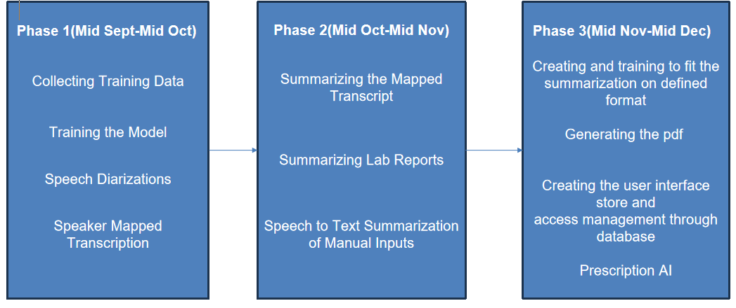
Timeline of Project

Slide 22
Outcomes/Result Obtained
1. Improved Documentation Accuracy:
OpenAI's Whisper model ensures over 70% transcription accuracy for medical conversations, even in noisy environments or with diverse accents, significantly reducing transcription errors and improving the reliability of medical records. Additionally, the system automatically detects and corrects medical jargon, accurately interpreting complex terminology. This ensures that clinicians receive faithful records of conversations, preventing miscommunications or misinterpretations that could compromise patient care.
2. Time Efficiency:
The system reduces clinician documentation time by about 50%, allowing more time for direct patient care. By automating transcription and report generation, it boosts operational efficiency and helps reduce clinician burnout, as less time is spent on administrative tasks. Additionally, real-time processing of audio inputs enables immediate transcription and report generation, minimizing delays in clinical workflows and providing clinicians with up-to-date patient information and recommendations, accelerating the decision-making process.

Slide 23
Outcomes/Result Obtained
3. Comprehensive Reporting:
The system generates reports that include not only transcriptions but also extracted symptoms, predicted diseases, and actionable recommendations, offering a comprehensive view of the clinician-patient interaction. These standardized reports are easy to read and integrate seamlessly with existing EHR systems, reducing manual data entry and ensuring patient records are consistently updated across all platforms, supporting more informed decision-making.
4. Enhanced Diagnostic Support
The machine learning model predicts diseases based on symptoms extracted from conversations, acting as a decision support tool to help clinicians diagnose conditions more effectively, especially when symptoms are subtle or ambiguous. Integration with medical databases allows for robust symptom-to-disease mapping, enabling the system to continuously learn and improve, ensuring high-confidence predictions of a wide range of diseases based on the latest clinical knowledge.

Slide 24
Conclusion
The Increase Clinician-Patient Facetime project marks a significant advancement in AI integration within healthcare, streamlining critical clinical workflows, enhancing diagnostic support, and improving patient care. By automating transcription, symptom extraction, and report generation, the system alleviates the administrative burden on clinicians, allowing them to focus more on patient interactions. Its high accuracy in disease prediction, along with the generation of structured, actionable reports, further enhances decision-making and clinical outcomes. The system’s scalability and adaptability across specialties and languages position it for global adoption, offering a reliable, future-proof solution for diverse healthcare settings. As the healthcare industry continues to embrace AI, this project exemplifies the transformative potential of technology in improving clinician productivity and delivering high-quality, patient-centered care.

Slide 25
Github Link
The Github link provided should have public access permission.
Github Link: https://github.com/Sake-Srinivas/Capstone-Project

Slide 26
References
Leong, H., Gao, Y., Shuai Ji, & Uktu Pamuksuz (2024). Efficient Fine-Tuning of Large Language Models for Automated Medical Documentation https://rgdoi.net/10.13140/RG.2.2.26884.74881
Ahamed, S., Weiler, G., Boden, K., Januschowski, K., Stennes, M., McCrae, P., Bock, C., Rawein, C., Petris, M., Foth, K., Rohm, K., & Kiefer, S. (2021). Deep Neural Network Driven Speech Classification for Relevance Detection in Automatic Medical Documentation. Studies in health technology and informatics, 281, 63–67. https://doi.org/10.3233/SHTI210121
Christino, M. A., Matson, A. P., Fischer, S. A., Reinert, S. E., Digiovanni, C. W., & Fadale, P. D. (2013). Paperwork versus patient care: a nationwide survey of residents' perceptions of clinical documentation requirements and patient care. Journal of graduate medical education, 5(4), 600–604. https://doi.org/10.4300/JGME-D-12-00377.1
Ali, J., Khan, R., Ahmad, N., & Maqsood, I. (2012). Random Forests and Decision Trees.
Cabello-Collado C, Rodriguez-Juan J, Ortiz-Perez D, Garcia-Rodriguez J, Tomás D, Vizcaya-Moreno MF. Automated Generation of Clinical Reports Using Sensing Technologies with Deep Learning Techniques. Sensors. 2024; 24(9):2751. https://doi.org/10.3390/s24092751
Zhang, J., Wu, J., Qiu, Y., Song, A., Li, W., Li, X., & Liu, Y. (2023). Intelligent speech technologies for transcription, disease diagnosis, and medical equipment interactive control in smart hospitals: A review. Computers in biology and medicine, 153, 106517. https://doi.org/10.1016/j.compbiomed.2022.106517
Vogel, M., Kaisers, W., Wassmuth, R., & Mayatepek, E. (2015). Analysis of Documentation Speed Using Web-Based Medical Speech Recognition Technology: Randomized Controlled Trial. Journal of medical Internet research, 17(11), e247. https://doi.org/10.2196/jmir.5072

Slide 27
References
Vogel, M., Kaisers, W., Wassmuth, R., & Mayatepek, E. (2015). Analysis of Documentation Speed Using Web-Based Medical Speech Recognition Technology: Randomized Controlled Trial. Journal of medical Internet research, 17(11), e247. https://doi.org/10.2196/jmir.5072
Quiroz, J. C., Laranjo, L., Kocaballi, A. B., Berkovsky, S., Rezazadegan, D., & Coiera, E. (2019). Challenges of developing a digital scribe to reduce clinical documentation burden. NPJ digital medicine, 2, 114. https://doi.org/10.1038/s41746-019-0190-1
Dergaa, I., Saad, H. B., El Omri, A., Glenn, J. M., Clark, C. C. T., Washif, J. A., Guelmami, N., Hammouda, O., Al-Horani, R. A., Reynoso-Sánchez, L. F., Romdhani, M., Paineiras Domingos, L. L., Vancini, R. L., Taheri, M., Mataruna-Dos-Santos, L. J., Trabelsi, K., Chtourou, H., Zghibi, M., Eken, Ö., Swed, S., … Chamari, K. (2024). Using artificial intelligence for exercise prescription in personalised health promotion: A critical evaluation of OpenAI's GPT-4 model. Biology of sport, 41(2), 221–241. https://doi.org/10.5114/biolsport.2024.133661
Biswas, A., & Talukdar, W. (2024). Intelligent Clinical Documentation: Harnessing Generative AI for Patient-Centric Clinical Note Generation. International Journal of Innovative Science and Research Technology (IJISRT), 994–1008. http://dx.doi.org/10.38124/ijisrt/IJISRT24MAY1483
Kernberg, A., Gold, J. A., & Mohan, V. (2024). Using ChatGPT-4 to Create Structured Medical Notes From Audio Recordings of Physician-Patient Encounters: Comparative Study. Journal of medical Internet research, 26, e54419. https://doi.org/10.2196/54419

Slide 28

Project work mapping with SDG

Slide 29
The project aligns with several Sustainable Development Goals (SDGs) as follows:
SDG 3: Good Health and Well-being – Improves healthcare delivery by automating medical transcription, symptom extraction, and report generation, leading to better diagnoses and patient care.
SDG 4: Quality Education – Provides an educational tool for healthcare professionals, promoting learning in AI-driven healthcare technologies.%
SDG 9: Industry, Innovation, and Infrastructure – Encourages technological innovation in healthcare and supports the development of smart healthcare infrastructure.
SDG 10: Reduced Inequalities – Enhances access to healthcare by improving efficiency, especially in underserved regions, and supports language inclusivity.
SDG 11: Sustainable Cities and Communities – Streamlines healthcare systems, reducing the burden on healthcare professionals and supporting smarter cities.
SDG 12: Responsible Consumption and Production – Reduces paper usage and increases efficiency, contributing to sustainable healthcare practices.
SDG 17: Partnerships for the Goals – Encourages partnerships with healthcare and tech organizations to improve healthcare delivery and innovation.

Slide 30
Thank You

